Slide 1
CS 106A, Lecture 14 Events and Instance Variables
Reading:
Art & Science of Java, Ch. 10.1-10.4

Slide 2




HW4:
Breakout
Memory
The River of Java
Events
You are here
Animation
Graphics
Programs

Slide 3
Plan for Today
Announcements
Review: animation and null
Event-driven programming
Instance variables
Whack-A-Mole
Extra: Googly Eyes

Slide 4
Announcements
BlueBook download available on the website
try it out with the second practice exam!
Assignment 3 due tomorrow
Assignment 4 out tomorrow
not due until the following Monday, but could be good exam practice for graphics + events

Slide 5
Plan for Today
Announcements
Review: animation and null
Event-driven programming
Instance variables
Whack-A-Mole
Extra: Googly Eyes

Slide 6
Animation
A Graphics program can be made to animate with a loop such as:
public void run() {
...
while (test) {
update the position of shapes;
pause(milliseconds);
}
}
The best number of ms to pause depends on the program.
most video games ~= 50 frames/sec = 25ms pause

Slide 7
Null
Null is a special variable value that objects can have that means “nothing”. Primitives cannot be null.
If a method returns an object, it can return null to signify “nothing”. (just say return null;)
// may be a GObject, or null if nothing at (x, y)
GObject maybeAnObject = getElementAt(x, y);
Objects have the value null before being initialized.
Scanner myScanner; // initially null
Notes:
Different from the empty string

Slide 8
Null
Calling methods on an object that is null will crash your program!
// may be a GObject, or null if nothing at (x, y)
GObject maybeAnObject = getElementAt(x, y);
if (maybeAnObject != null) {
int x = maybeAnObject.getX(); // OK
} else {
int x = maybeAnObject.getX(); // CRASH!
}
Notes:
Think about null like an “invalid mailing address” – if you try to send messages to it, your messages bounce because the address is invalid

Slide 9
Plan for Today
Announcements
Review: animation and null
Event-driven programming
Instance variables
Whack-A-Mole
Extra: Googly Eyes

Slide 10
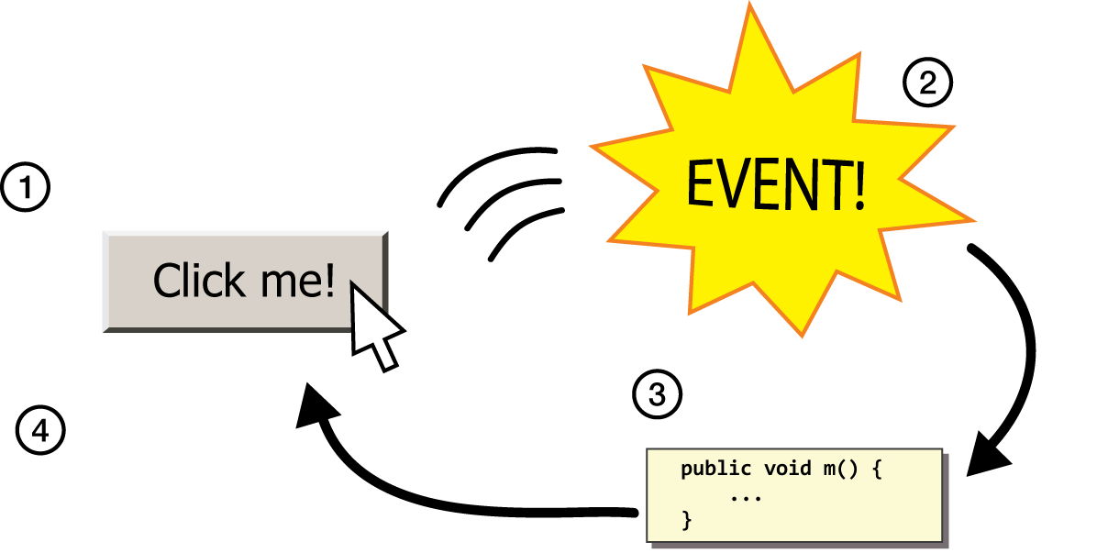
Events
event: Some external stimulus that your program can respond to.
event-driven programming: A coding paradigm (common in graphical programs) where your code is executed in response to user events.

Slide 11
Events
Program launches
Notes:
When that event happens, Java looks for a method in your program called public void run and executes the code there. Today, we’re going to learn about other types of events besides your program launching. There are lots of them! And it turns out you can also have Java run certain code when those things happen, too.

Slide 12
Events
Program launches
Mouse motion
Mouse clicking
Keyboard keys pressed
Device rotated
Device moved
GPS location changed
and more…
Notes:
These are events triggered by the user – like mouse clicks, or mouse drags. On mobile devices, there are even more.
We are now just demoting run to be “another event” that is triggered by the user

Slide 13
Events
Program launches
Mouse motion
Mouse clicking
Keyboard keys pressed
Device rotated
Device moved
GPS location changed
and more…
Notes:
We’re just going to focus on the mouse today.
These can happen in any order – mouse events even after run finishes!

Slide 14
Events
public void run() {
// Java runs this when program launches
}
Notes:
The rule in Java though is that the code for each event needs to go in its own method. That way Java knows what to execute for each event. They also have to be named exactly how Java wants, so it knows where to look. So we have a method for the code that should be run when the program launches (public void run()). And we also will have a method for the code that should run when the user clicks the mouse, and a method that should run when the user drags the mouse, etc.

Slide 15
Events
public void run() {
// Java runs this when program launches
}
public void mouseClicked(MouseEvent event) {
// Java runs this when mouse is clicked
}
Notes:
these new methods also have to be specifically named.

Slide 16
Events
public void run() {
// Java runs this when program launches
}
public void mouseClicked(MouseEvent event) {
// Java runs this when mouse is clicked
}
public void mouseMoved(MouseEvent event) {
// Java runs this when mouse is moved
}
Notes:
these new methods also have to be specifically named.
Just like run, these methods are called by Java, not by our code!

Slide 17
Example: ClickForDaisy
import acm.program.*;
import acm.graphics.*;
import java.awt.*;
import java.awt.event.*; // NEW
public class ClickForDaisy extends GraphicsProgram {
// Add a Daisy image at 50, 50 on mouse click
public void mouseClicked(MouseEvent event) {
GImage daisy = new GImage("res/daisy.png", 50, 50);
add(daisy);
}
}
Notes:
No run method!
Make sure prototype is exact!
Show working program.
Adds daisies always at the same location
This is nice, but not very exciting if we can only add a Daisy image at one location. It would be cool if we could get information about the event that just happened. Luckily, we can! You’ll notice something different here from run() – it takes a parameter! This is because when an event happens, Java will call our method and pass us some information about the event in this parameter.

Slide 18
MouseEvent Objects
A MouseEvent contains information about the event that just occurred:
Method | Description
e.getX() | the x-coordinate of mouse cursor in the window
e.getY() | the y-coordinate of mouse cursor in the window
Notes:
Let’s try to use this parameter to make our ClickForDaisy program better – let’s add Daisy wherever the user clicks the mouse!

Slide 19
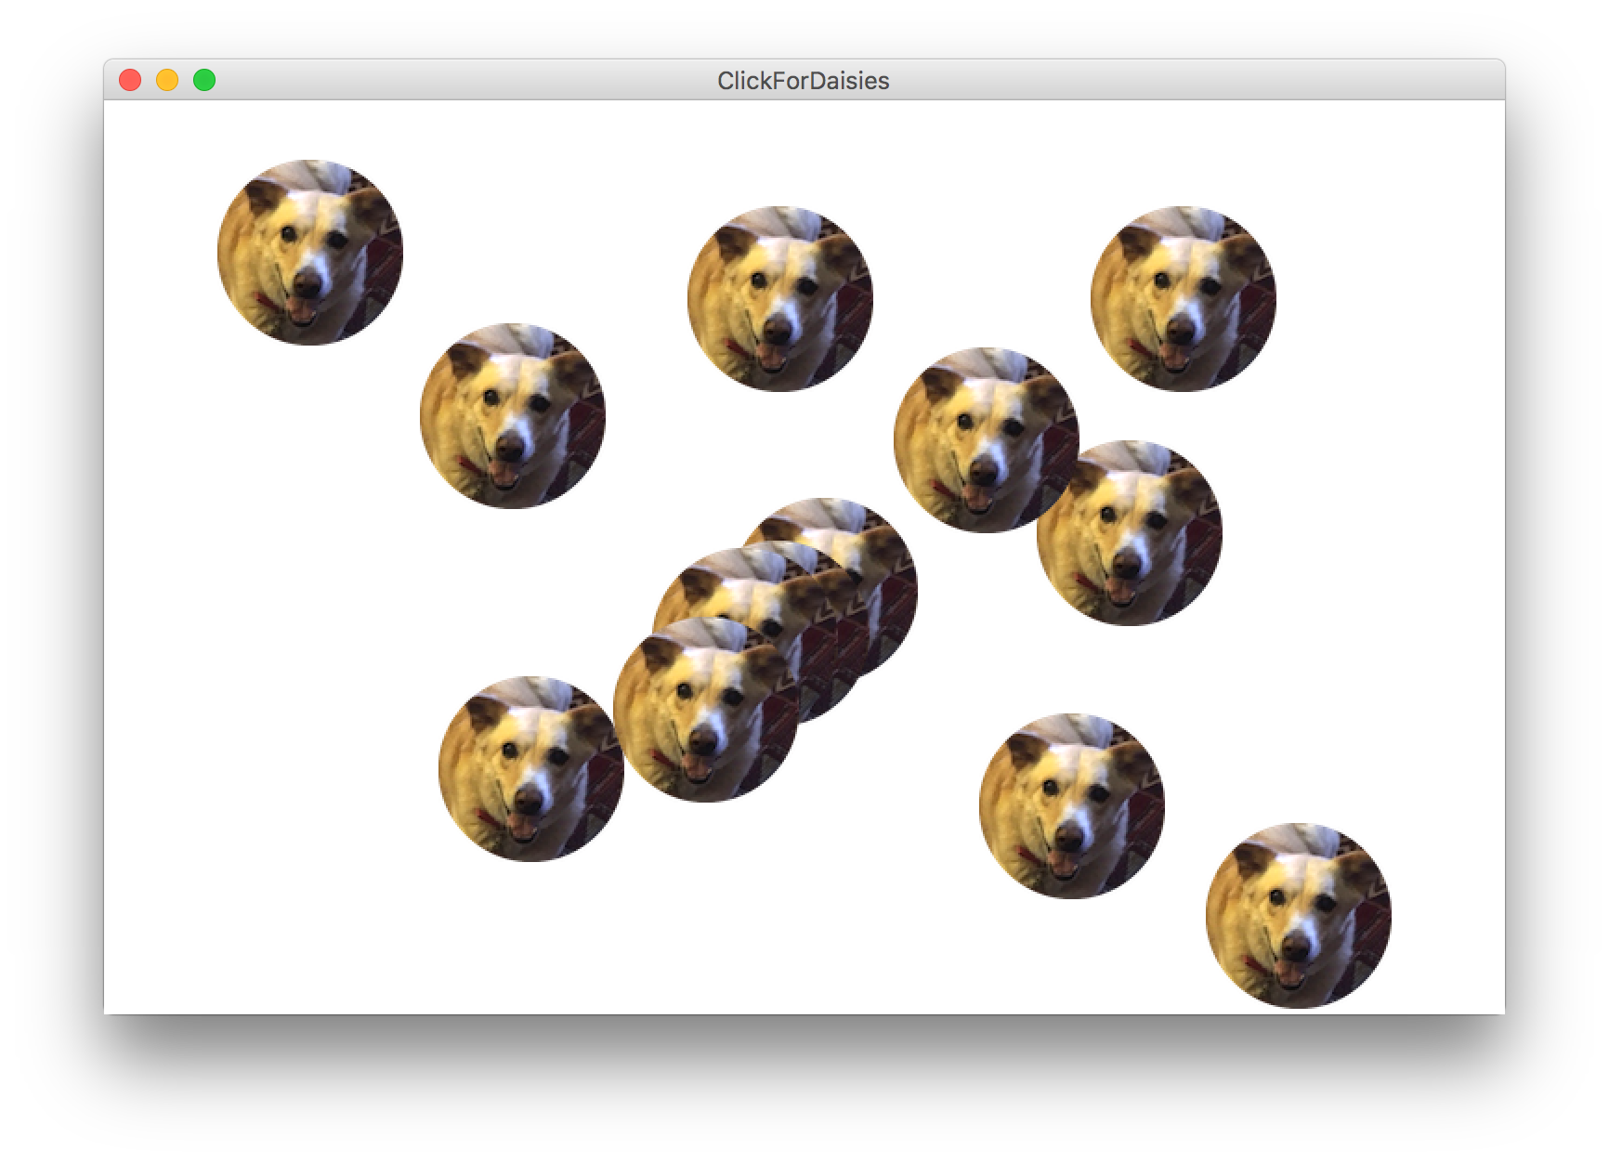
Example: ClickForDaisies
Notes:
How would we do this?

Slide 20
Example: ClickForDaisies
public class ClickForDaisies extends GraphicsProgram {
// Add a Daisy image where the user clicks
public void mouseClicked(MouseEvent event) {
// Get information about the event
double mouseX = event.getX();
double mouseY = event.getY();
// Add Daisy at the mouse location
GImage daisy = new GImage("res/daisy.png", mouseX, mouseY);
add(daisy);
}
}

Slide 21
Example: ClickForDaisies
public class ClickForDaisies extends GraphicsProgram {
// Add a Daisy image where the user clicks
public void mouseClicked(MouseEvent event) {
// Get information about the event
double mouseX = event.getX();
double mouseY = event.getY();
// Add Daisy at the mouse location
GImage daisy = new GImage("res/daisy.png", mouseX, mouseY);
add(daisy);
}
}
Notes:
One problem – where does Daisy show up?
Show working program.

Slide 22
Types of Mouse Events
There are many different types of mouse events.
Each takes the form: public void eventMethodName(MouseEvent event) { ...
Method | Description
mouseMoved | mouse cursor moves
mouseDragged | mouse cursor moves while button is held down
mousePressed | mouse button is pressed down
mouseReleased | mouse button is lifted up
mouseClicked | mouse button is pressed and then released
mouseEntered | mouse cursor enters your program's window
mouseExited | mouse cursor leaves your program's window
Notes:
We’ve just talked about mouseClicked – there are many other types of mouse events you can react to!
You can detect multiple events, but multiple mouse events can’t happen simultaneously
HOWEVER – run can execute simultaneously with mouse events
mouse dragged called many times while mouse is dragged – we can take advantage of this!

Slide 23
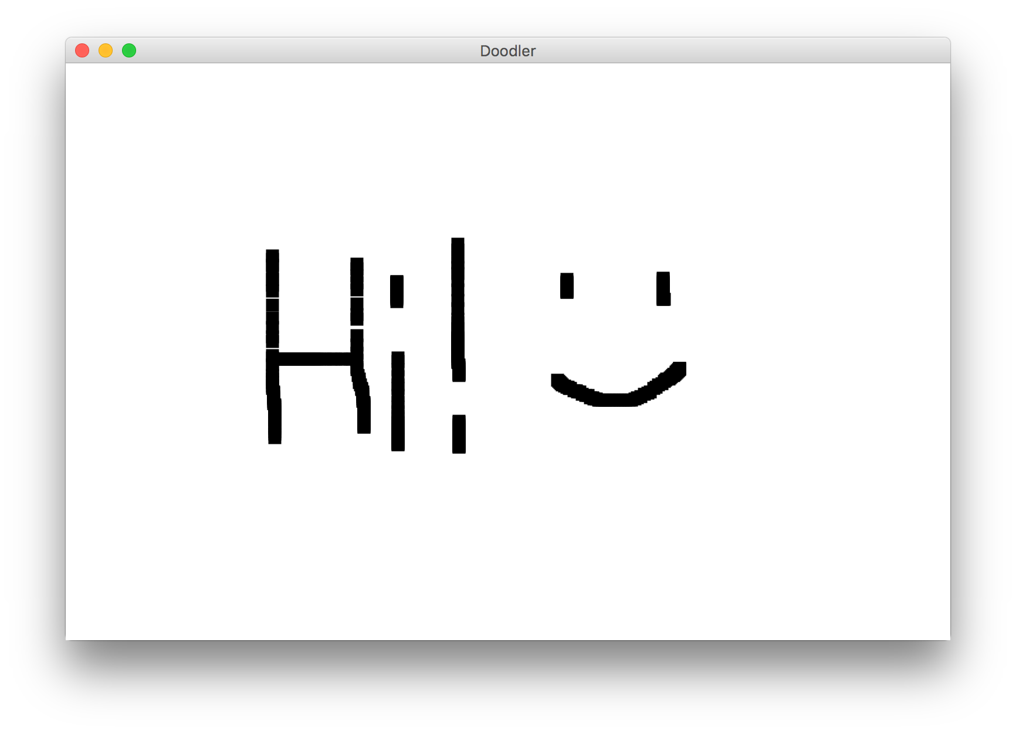
Example: Doodler
Notes:
Let’s look at an example with mouseDragged – let’s write a program that lets the user drag the mouse and drag

Slide 24
Doodler
private static final int SIZE = 10;
...
public void mouseDragged(MouseEvent event) {
double mouseX = event.getX();
double mouseY = event.getY();
double rectX = mouseX – SIZE / 2.0;
double rectY = mouseY – SIZE / 2.0;
GRect rect = new GRect(rectX, rectY, SIZE, SIZE);
rect.setFilled(true);
add(rect);
}
Notes:
Let’s step through

Slide 25
Doodler
public void mouseDragged(MouseEvent event) {
double mouseX = event.getX();
double mouseY = event.getY();
double rectX = mouseX – SIZE / 2.0;
double rectY = mouseY – SIZE / 2.0;
GRect rect = new GRect(rectX, rectY, SIZE, SIZE);
rect.setFilled(true);
add(rect);
}

Slide 26
Doodler
public void mouseDragged(MouseEvent event) {
double mouseX = event.getX();
double mouseY = event.getY();
double rectX = mouseX – SIZE / 2.0;
double rectY = mouseY – SIZE / 2.0;
GRect rect = new GRect(rectX, rectY, SIZE, SIZE);
rect.setFilled(true);
add(rect);
}

Slide 27
Doodler
public void mouseDragged(MouseEvent event) {
double mouseX = event.getX();
double mouseY = event.getY();
double rectX = mouseX – SIZE / 2.0;
double rectY = mouseY – SIZE / 2.0;
GRect rect = new GRect(rectX, rectY, SIZE, SIZE);
rect.setFilled(true);
add(rect);
}

Slide 28
Doodler
public void mouseDragged(MouseEvent event) {
double mouseX = event.getX();
double mouseY = event.getY();
double rectX = mouseX – SIZE / 2.0;
double rectY = mouseY – SIZE / 2.0;
GRect rect = new GRect(rectX, rectY, SIZE, SIZE);
rect.setFilled(true);
add(rect);
}
Notes:
Show working program – question: why does it slow down when I move faster?

Slide 29
Review: animation and null: Events
1) User performs some action, like moving / clicking the mouse.
2) This causes an event to occur.
3) Java executes a particular method to handle that event.
4) The method's code updates the screen appearance in some way.
Notes:
This whole concept is called event-driven programming, and is a common way to write Graphics programs, since users can interact with them and you want to do things when they interact with them.
This is different from how we have programmed so far, because unlike with run() we don’t know when our code will execute! It could be in any order.

Slide 30
Revisiting Doodler
public void mouseDragged(MouseEvent event) {
double mouseX = event.getX();
double mouseY = event.getY();
double rectX = mouseX – SIZE / 2.0;
double rectY = mouseY – SIZE / 2.0;
GRect rect = new GRect(rectX, rectY, SIZE, SIZE);
rect.setFilled(true);
add(rect);
}
What if we wanted the same GRect to track the mouse, instead of making a new one each time?
Notes:
No way to do this! We can’t pass parameters since we don’t call mouse event methods
No way for information to live between mouse dragged calls – no variables live then!
No way to access information about previous drag

Slide 31
Plan for Today
Announcements
Review: animation and null
Event-driven programming
Instance variables
Whack-A-Mole
Extra: Googly Eyes

Slide 32
Instance Variables
private type name; // declared outside of any method
Instance variable: A variable that lives outside of any method.
The scope of an instance variable is throughout an entire file (class).
Useful for data that must persist throughout the program, or that cannot be stored as local variables or parameters (event handlers).
It is bad style to overuse instance variables
DO NOT USE INSTANCE VARIABLES ON SNOWMAN!
Notes:
Because they have a large scope, it is considered bad style to use too many instance variables, or to make something an instance variable that could instead be a local variable, parameter, return, etc.

Slide 33
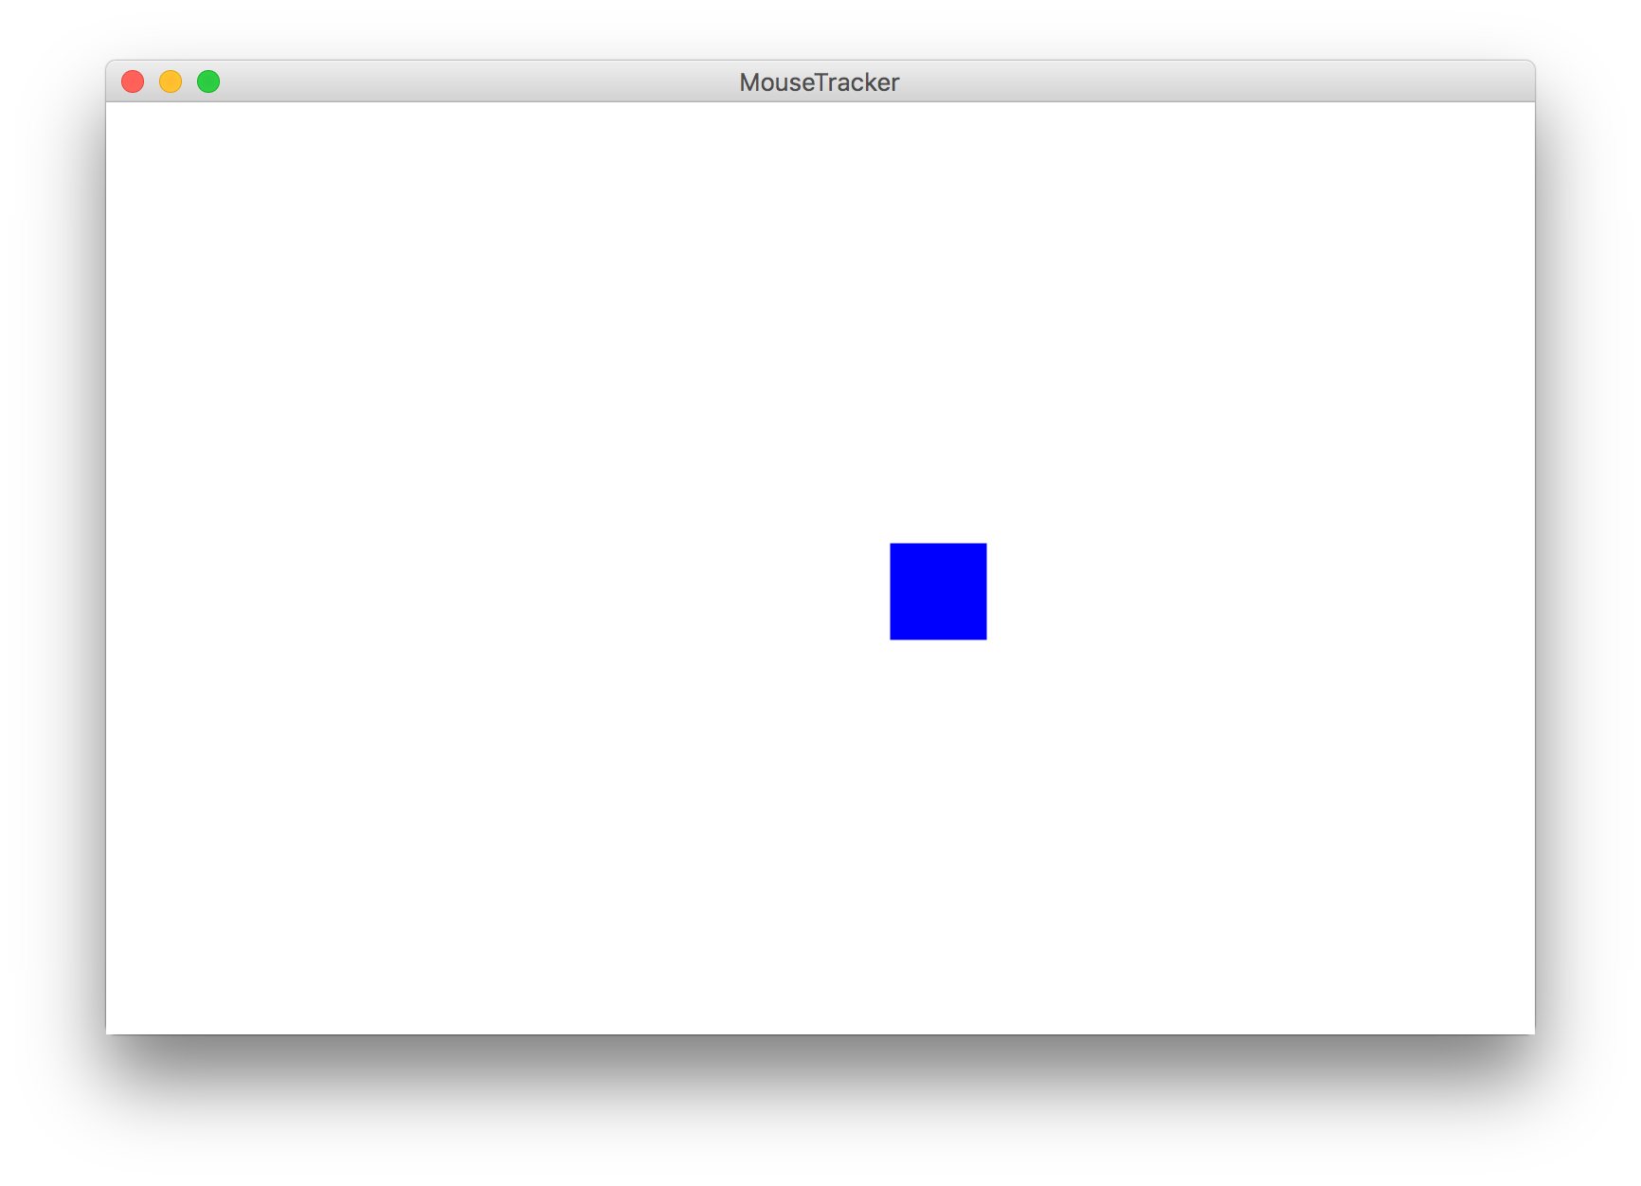
Example: MouseTracker
Notes:
Write mouseTracker with creating Grect in run, moving grect in mouse moved. Then, show that we can’t access Grect in mouse moved. We need a field! Show code, add field.

Slide 34
Plan for Today
Announcements
Review: animation and null
Event-driven programming
Instance variables
Whack-A-Mole
Extra: Googly Eyes

Slide 35
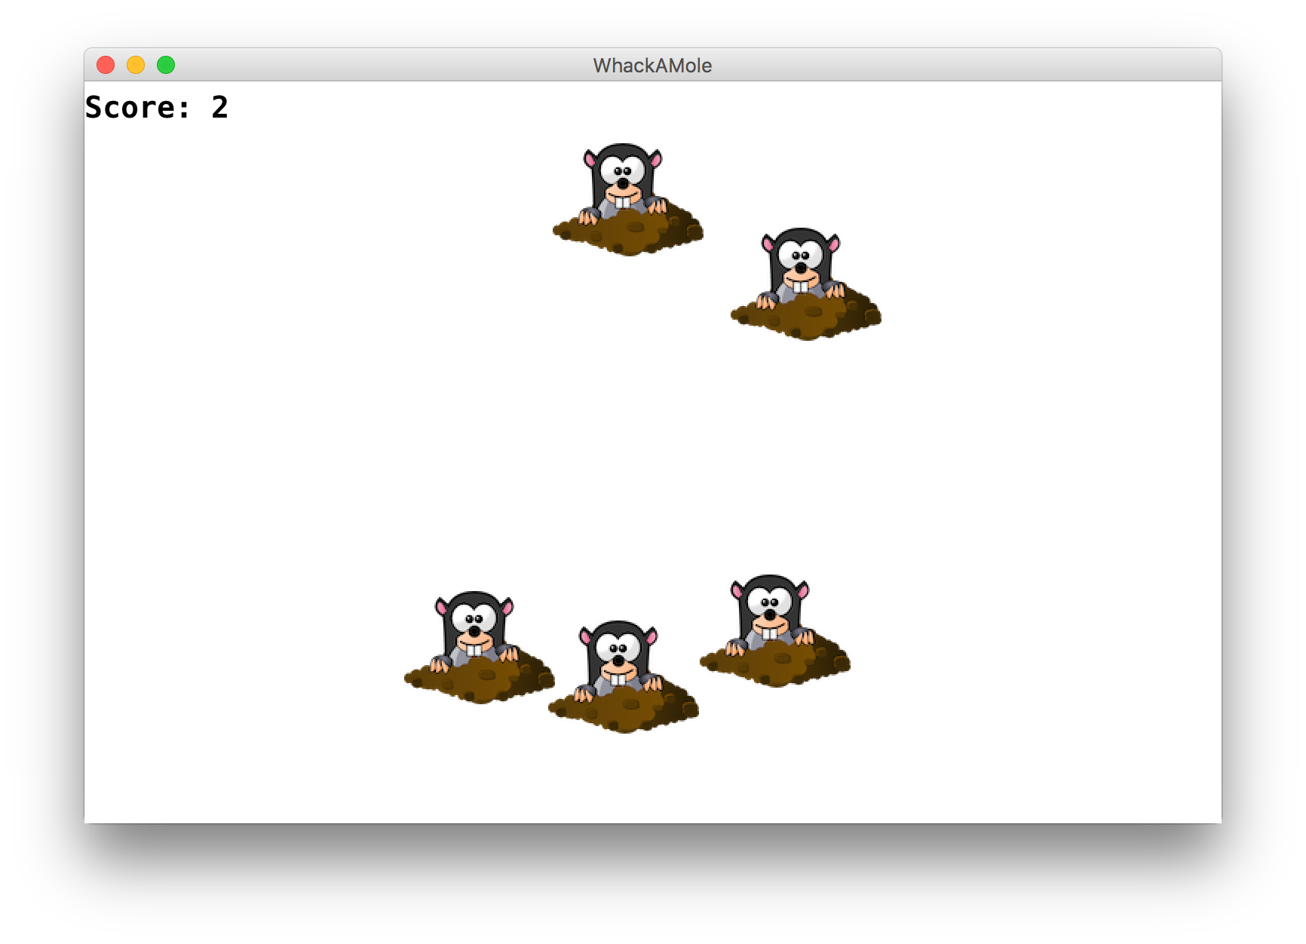
Putting it all together

Slide 36
Whack-A-Mole
Let’s use instance variables and events to make Whack-A-Mole!
A mole should appear every second at a random location, and stop once the user has gotten at least 10 points.
If the user clicks a mole, remove it and increase their score by 1
There should be a GLabel in the left corner showing their score
Notes:
Show demo first
Think-pair-share: what events might we want to respond to, and what instance variables might we need?
Run: adding moles
MouseClicked – remove moles, increment score
Ivars: label and score

Slide 37
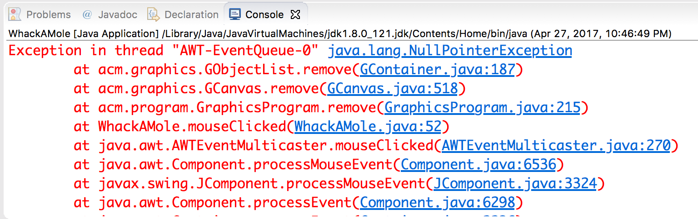
Exception
If the user clicks an area with no mole, the program crashes.
A program crash in Java is called an exception.
When you get an exception, Eclipse shows red error text.
The error text shows the line number where the error occurred.
Why did this error happen?
How can we avoid this?
Notes:
How to interpret crash messages

Slide 38
Plan for Today
Announcements
Review: animation and null
Event-driven programming
Instance variables
Whack-A-Mole
Extra: Googly Eyes

Slide 39
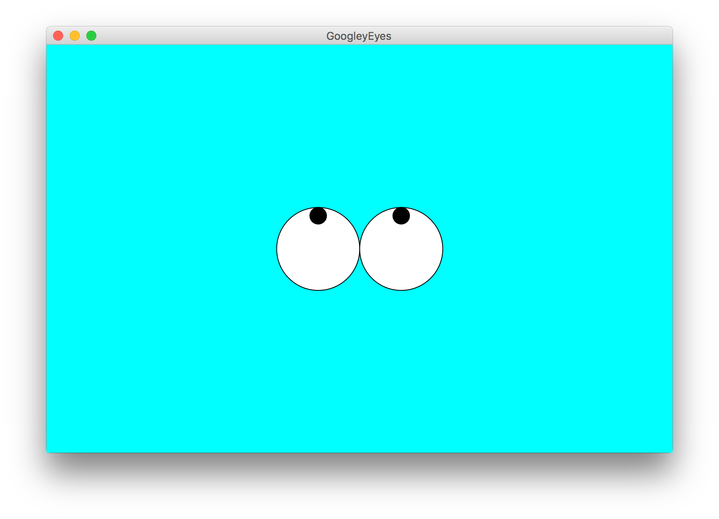
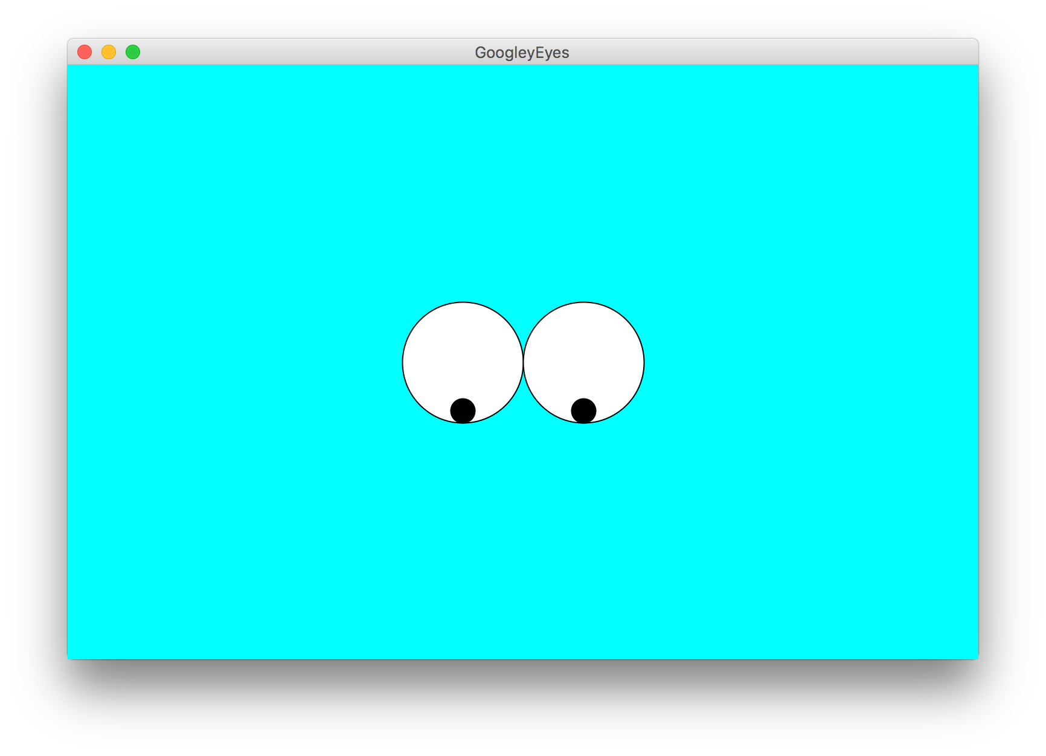

Extra Practice: GooglyEyes
Let’s write a program called GooglyEyes that draws eyes whose pupils follow the user’s mouse vertically as it moves around.

Slide 40
Plan for Today
Announcements
Review: animation and null
Event-driven programming
Instance variables
Whack-A-Mole
Extra: Googly Eyes
Next Time: Memory

